Slide 1
Sujal Patel
Book Service

Slide 2
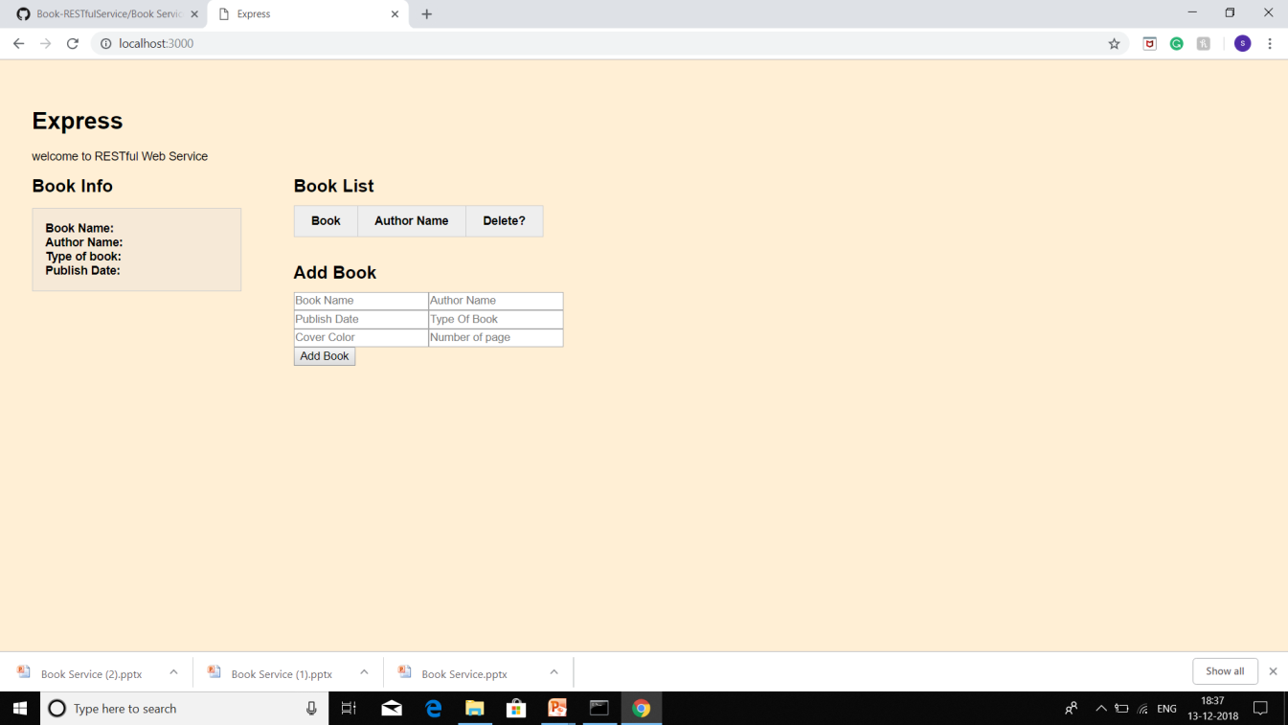
Book Service
Service shows the information about
Book Name
Author name
Type of Book
Publish Date

